Slide 1
Superstore Sales Analysis
Digital Egypt Pioneers Initiative Project

Slide 2
Project Objectives
Evaluate overall sales performance and identify key trends
Determine best-selling products and categories Analyze customer segments and their distribution
Examine order trends across time periods, regions, and channels Support data-driven decision-making in marketing and sales strategy

Slide 3
Project Scope
Dataset: Superstore sales data with order details, customer information, and product data
Tools: Power BI (Power Query – DAX)
Methodology: Data cleaning, modeling, and visualization
Analysis Focus: Sales trends, regional performance, product categories, customer segments
Data Analysis Workflow
Data Collection & Extraction Data Cleaning & Transformation Data Modeling & Relationships
Dashboard Creation & Visualization
Insight Generation & Recommendations

Slide 4
Key Questions We Asked
How are sales distributed over time and geography?
Who are our top customers and products?
Which segments drive revenue?
What affects shipping time and sales growth?

Slide 5
Data Cleaning
Load Data into Power Query
Convert Data Types (Ensure that each column has the correct data type):
Remove duplicates and errors
Add Custom Column "Shipping Duration"
Replaced empty cells in Postal Code Column
Defined a new Product Id

Slide 6
Data Model Structure
Star schema design with fact and dimension tables
Sales (Fact Table): Order ID, Order Date, Sales, Ship Date, etc.
Dimension Tables: Date, Product, Customer, Address
One-to-many relationships for efficient filtering and analysis
Star Schema Model
Table | Type | Key Fields | Related Tables
Sales | Fact | Order ID, Product ID, Customer ID | Product, Customer, Date
Product | Dimension | Product ID | Sales
Customer | Dimension | Customer ID | Sales, Address
Date | Dimension | Date ID | Sales
Address | Dimension | Address ID | Customer

Slide 7
Data Model Structure
Star schema design with fact and dimension tables
Sales (Fact Table): Order ID, Order Date, Sales, Ship Date, etc.
Dimension Tables: Date, Product, Customer, Address
One-to-many relationships for efficient filtering and analysis
Star Schema Model
Table | Type | Key Fields | Related Tables
Sales | Fact | Order ID, Product ID, Customer ID | Product, Customer, Date
Product | Dimension | Product ID | Sales
Customer | Dimension | Customer ID | Sales, Address
Date | Dimension | Date ID | Sales
Address | Dimension | Address ID | Customer

Slide 8
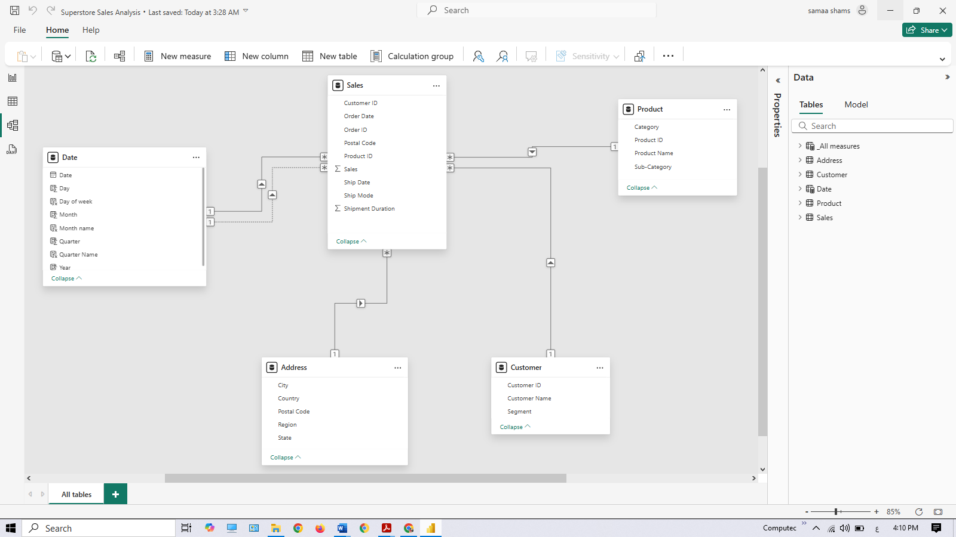
Data Model Structure

Slide 9
Regional & Product Insights
Regional Insights
California is the top-performing state in sales Top cities:
Los Angeles
New York City Philadelphia San Francisco Seattle
Product Insights
Top sub-categories:
Phones ($0.33M)
Chairs ($0.32M) Best-selling products:
Easy-staple paper
Staple envelope Staples
State | Sales | % of Total
California | $457,688 | 16.4%
New York | $310,557 | 11.1%
Texas | $170,185 | 6.1%
Category | Sales | % of Total
Technology | $836,154 | 36.5%
Furniture | $741,999 | 32.4%
Office Supplies | $719,047 | 31.1%

Slide 10
Customer Insights
Consumer segment dominates with 50.7% of total sales
Corporate (30.45%) and Home Office (18.78%) segments
Top customer: Emily Phan with 17 orders
793 unique customers served across all segments
Customer Segment Distribution
Segment | Sales | % of Total | Customers | Avg. Order
Consumer | $1,161,401 | 50.72% | 410 | $456
Corporate | $706,146 | 30.45% | 245 | $515
Home Office | $429,653 | 18.78% | 138 | $488
Top Customers by Orders
Customer | Orders | Total Sales
Emily Phan | 17 | $17,485
Sean Miller | 15 | $14,738
Adrian Barton | 13 | $13,156

Slide 11
Key Performance Drivers
Shipping Performance
Ship Mode is the primary factor in reducing shipping days
Same Day shipping reduces average shipping by 4.14 days
Sales Drivers
Product sub-category most influences total sales
Tables, Chairs, and Technology drive highest sales increases
Ship Mode | % of Orders | Avg. Ship Days
Standard Class | 59.83% | 5.03
Second Class | 18.48% | 3.16
First Class | 15.27% | 2.24
Same Day | 6.42% | 0.89
Sub-Category | Sales | Profit Margin
Phones | $330,007 | 19.8%
Chairs | $328,449 | 9.3%
Storage | $223,843 | 6.7%
Tables | $206,966 | 8.2%
Binders | $203,413 | 14.5%

Slide 12
Project Highlights
Clear upward trend in sales and orders from 2015-2018
West region and California are dominant markets Consumer segment is the primary revenue driver Standard Class shipping is most common (59.83%) Average shipment time is 4 days
Key Metric | Value | Insight
Total Sales (2015-2018) | $2,781,715 | Consistent growth pattern
Total Orders | 6,600 | Average order value: $421
Total Customers | 793 | Average orders per customer: 8.3
Profit Margin | 12.4% | Technology has highest margin

Slide 13
Strategic Recommendations
Focus marketing efforts on West and East regions
Promote fast shipping options to improve customer satisfaction Maintain strong inventory of top-selling products
Develop targeted campaigns for Consumer segment Implement personalized marketing based on customer data
Implementation Timeline
Strategy | Timeline | Expected Impact
Regional marketing campaigns | Q2 2025 | 15% increase in West/East sales
Shipping optimization program | Q3 2025 | 10% reduction in delivery time
Customer segment targeting | Q2-Q4 2025 | 20% increase in repeat purchases
Product inventory management | Immediate | 5% reduction in stockouts

Slide 14
Team Members
Mariam Abdelhai Soliman
Samaa Ali Ibrahim
Mohamed Soliman El Atroush
Supervised by: Mohamed Atyea

